Slide 1
Examples

Slide 2
Rotating Accumulator
RAR (Rotate Acc Right through Carry)
CY ⇒ A₇, A₇ ⇒ A₆, ….. A₁ ⇒ A₀ , A₀ ⇒ CY
RRC Rotate Acc Right without Carry)
A₇ ⇒ A₆, ….. A₁ ⇒ A₀ , A₀ ⇒ A₇ , A₀ ⇒ CY
CY
A₇
A₆
A₅
A₄
A₃
A₂
A₁
A₀
CY
A₇
A₆
A₅
A₄
A₃
A₂
A₁
A₀

Slide 3
Example : RAR(Rotate Acc Right through Carry)
CY ⇒ A₇, A₇ ⇒ A₆, ….. A₁ ⇒ A₀ , A₀ ⇒ CY
Before the inst
81H
CY=0
₁
₀
₀
₀
₀
₀
₀
₁
After the RAR A instruction
40H
CY=1
₀
₁
₀
₀
₀
₀
₀
₀

Slide 4
Example: RRC(Rotate Acc Right without Carry)
A₇ ⇒ A₆, ….. A₁ ⇒ A₀ , A₀ ⇒ A₇ , A₀ ⇒ CY
Before the inst
81H
CY=0
₁
₀
₀
₀
₀
₀
₀
₁
After the RRC A instruction
C0H
CY=1
₁
₁
₀
₀
₀
₀
₀
₀

Slide 5
RAL (Rotate Acc Left through Carry)
CY ← A₇, A₇ ← A₆, ….. A₁ ← A₀ , A₀ ← CY
RLC (Rotate Acc Left without Carry)
CY ← A₇, A₇ ← A₆, ….. A₁ ← A₀ , A₀ ← A₇
CY
A₇
A₆
A₅
A₄
A₃
A₂
A₁
A₀
CY
A₇
A₆
A₅
A₄
A₃
A₂
A₁
A₀

Slide 6
Example: RAL(Rotate Acc Left through Carry)
CY ← A₇, A₇ ← A₆, ….. A₁ ← A₀ , A₀ ← CY
Before the inst
AAH
CY
A7
A6
A5
A4
A3
A2
A1
A0
₀
₁
₀
₁
₀
₁
₀
₁
₀
After the RAL A instruction
54H
₁
₀
₁
₀
₁
₀
₁
₀
₀
After one more RAL A instruction
A9H
₀
₁
₀
₁
₀
₁
₀
₀
₁

Slide 7
Example: RLC (Rotate Acc Left without Carry)
CY ← A₇, A₇ ← A₆, ….. A₁ ← A₀ , A₀ ← A₇
Before the inst
AAH
CY=0
₁
₀
₁
₀
₁
₀
₁
₀
After the RLC A instruction
55H
₁
₀
₁
₀
₁
₀
₁
₀
₁
After one more RLC A instruction
AAH
₀
₁
₀
₁
₀
₁
₀
₁
₀

Slide 8
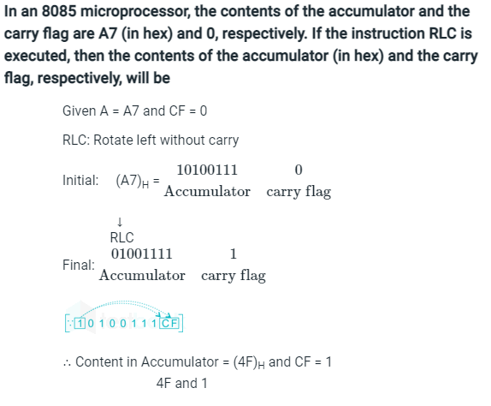

Slide 9
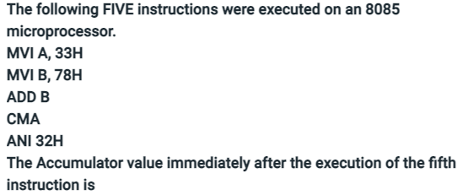
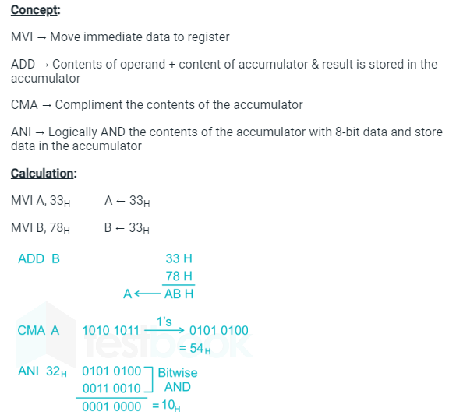

Slide 10
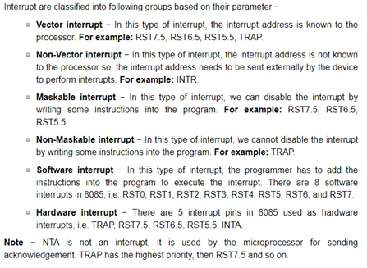
Interrupts:

